Slide 1

M
16

Slide 2


Slide 3

M16 INTERIOR
PRESENTATION

Slide 4

Introduction
M16 POS existence began in 23 April 2018
due to the worries of some Internet café
owners not feeling secured when leaving their
staff behind with business. So there is proof requested
from the business owners at the end of the day regardless of
some styles of doing readings based on the sales and services offered.

Slide 5
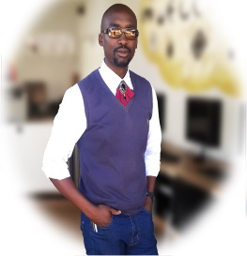
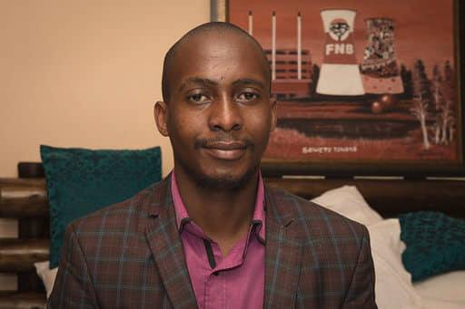
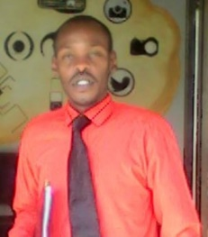
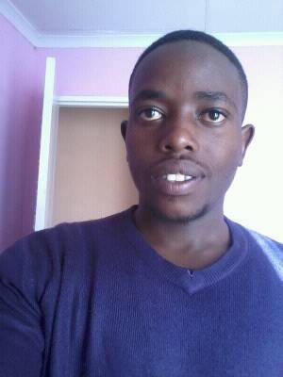
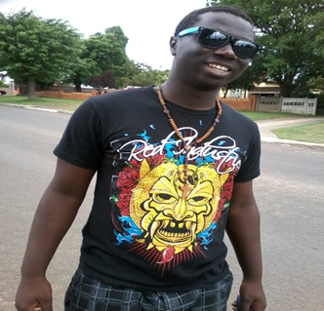

Founder & Director at M.I.T Bheki Siyabonga Masikane.
________________
Co Founder & Managing Director at M.I.T Ace Andile Masikane
__________________
Chief Of Software Engineering at M.I.T Prince VXIII Mosa Matthews Moabi Gcinisa.
__________________
Founder Of H.O.S
Co Founder & Chief Operating Officer at H.O.S
Mr. Siyanda Marvin Madiba
___________________
Co founder & Head of Q&A and Chief Technology Officer at H.O.S
Dr. Kwame Boaduo
___________________

Slide 6

We are changing the world with M16 Interior

Slide 7


Slide 8
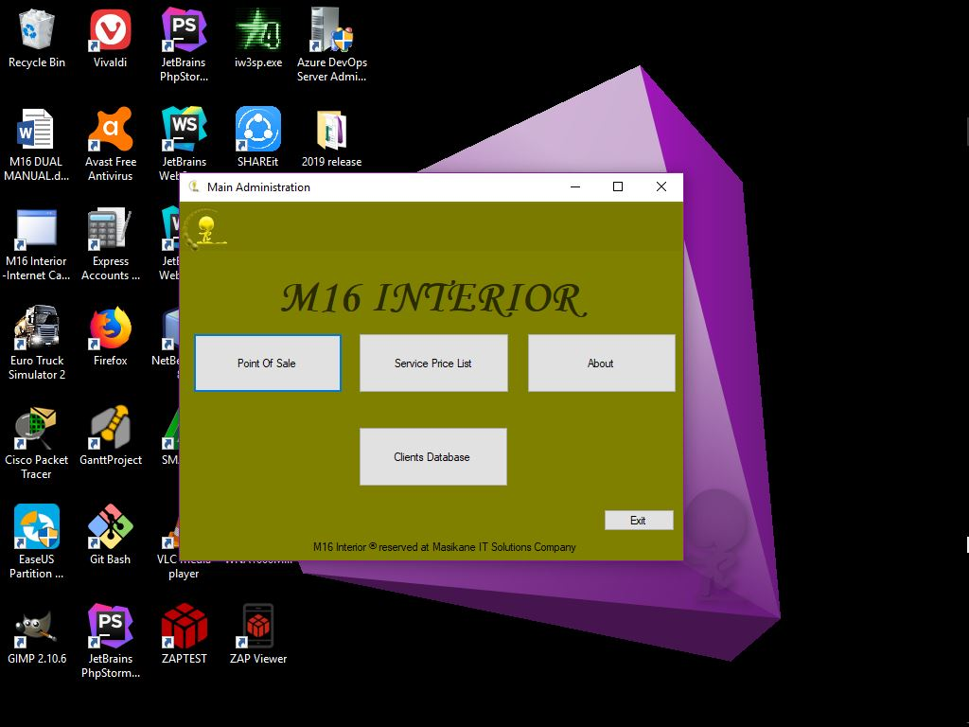

Slide 9
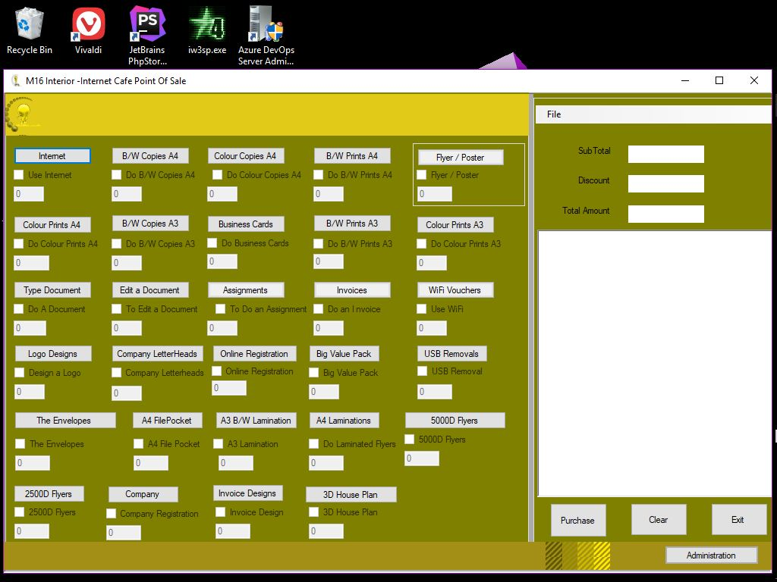

Slide 10
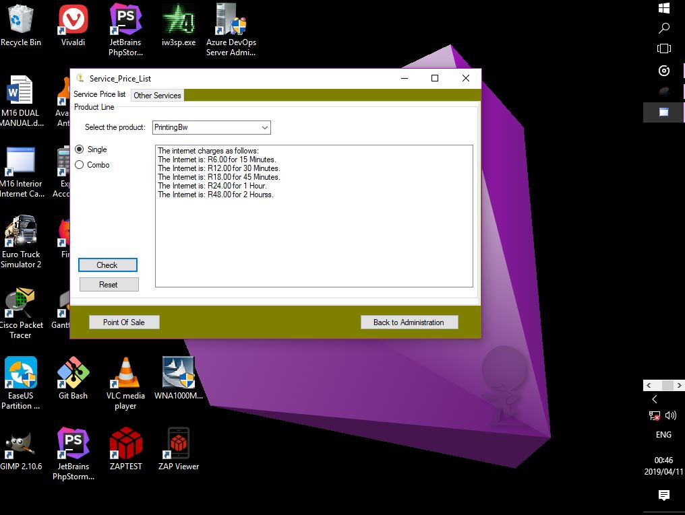

Slide 11
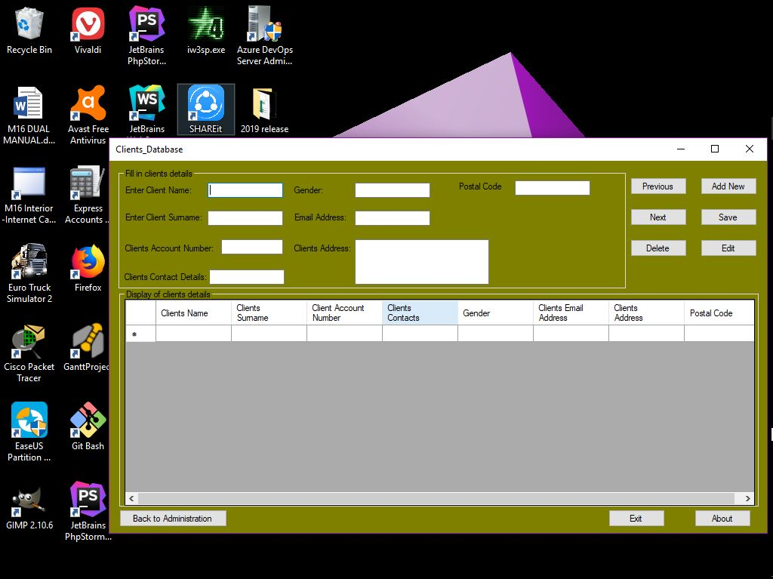

Slide 12
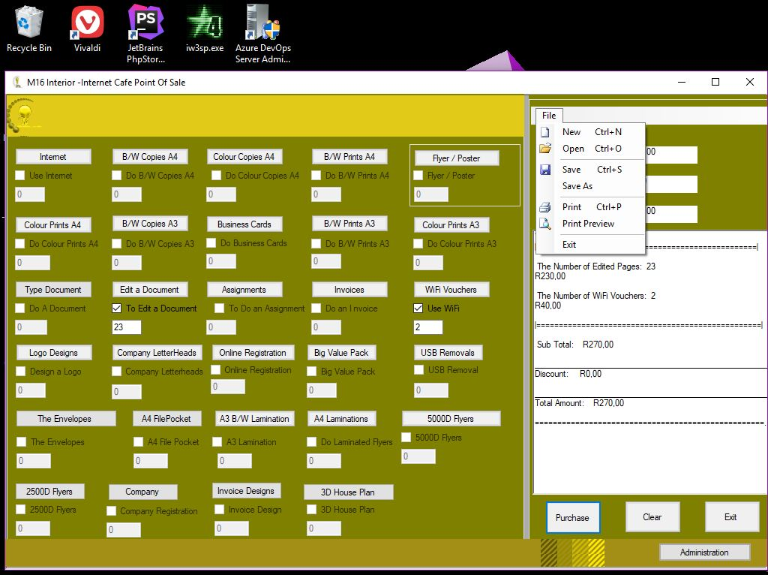

Slide 13
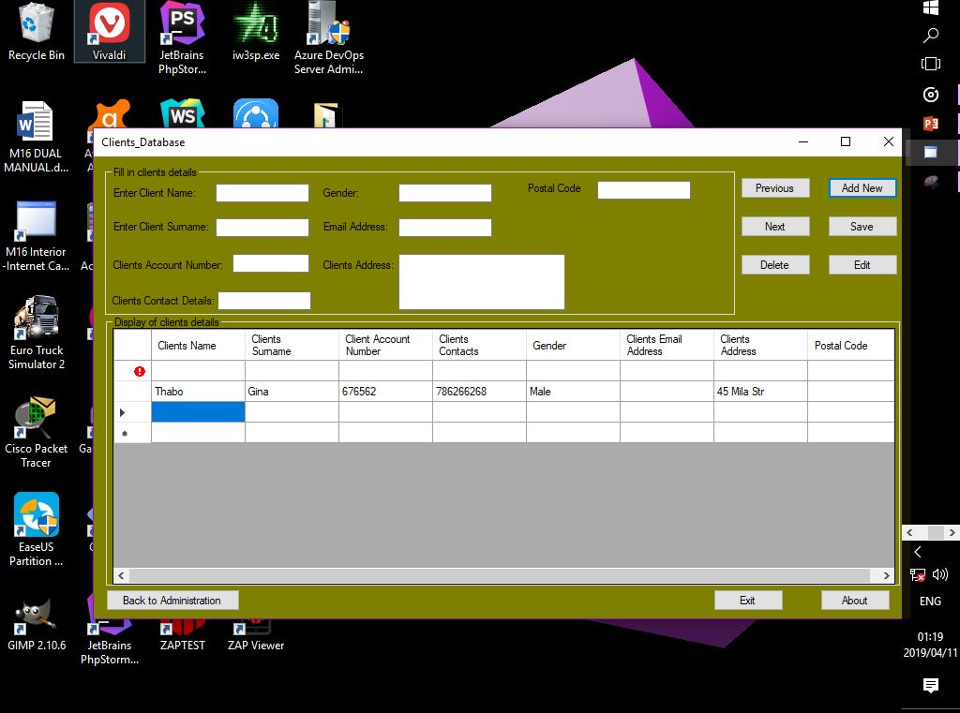

Slide 14
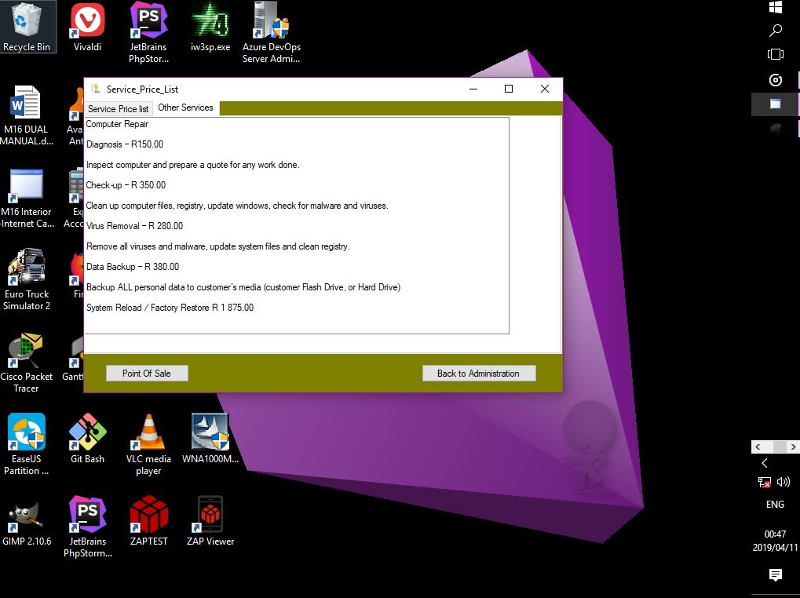

Slide 15
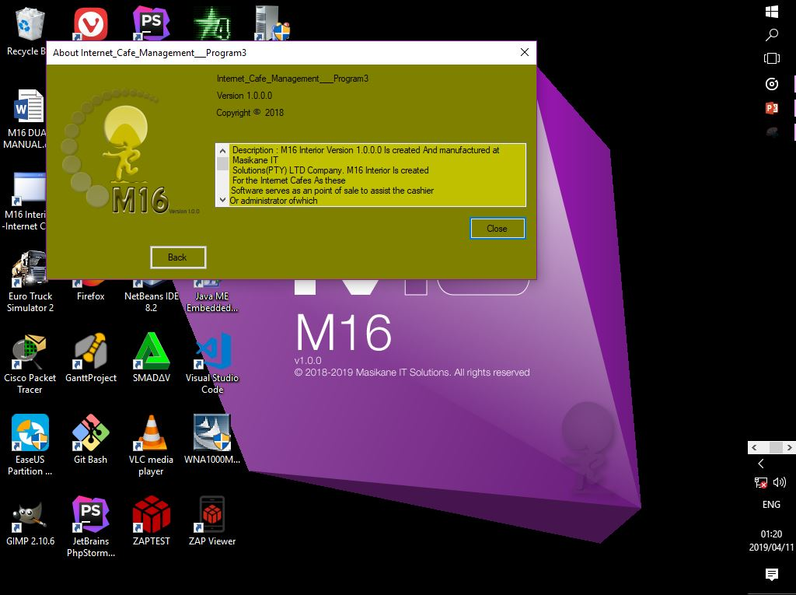

Slide 16

Get In Touch With - Prof
7637 Maleka Streeet Street,
Dobsonville, Roodepoort South, Gauteng
1863
+27 (0) 62 58 10101
profmosa@gmail.com
Princevxiii.mosamoabi@programmer.net

Slide 17


Presented by:

Slide 18
The End
Thank You

